Slide 1
PRESENTATION OF THE PRACTICAL EXAM
BY
Reg no. 2023-B072-30327
Uganda martyrs university
Masaka campus

Slide 2
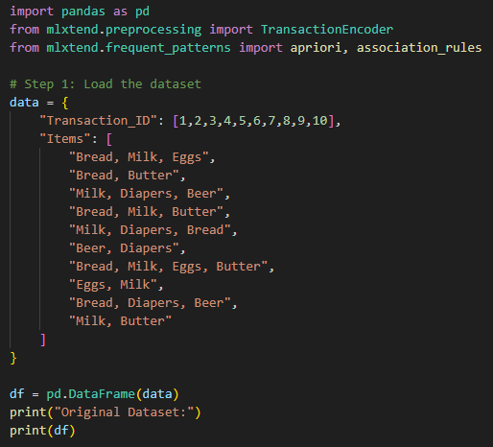
DATA PREPARATION.
Loading the dataset into dataframe

Slide 3
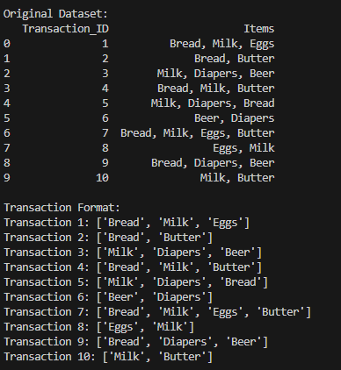
Result of dataframe

Slide 4
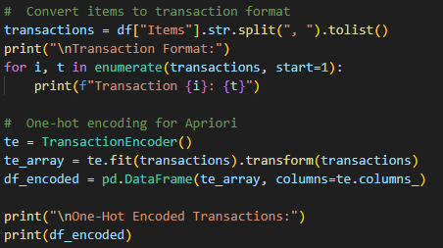
Transaction format for apriori algorithm and one-hot encoded format

Slide 5
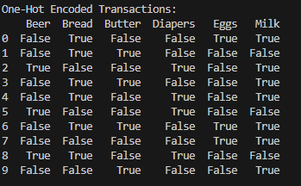
Results of the algorithm

Slide 6
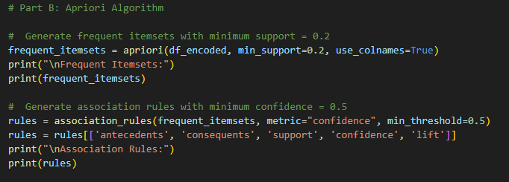
Apriori algorithm

Slide 7
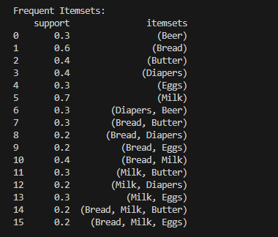
Frequent itemset generation

Slide 8
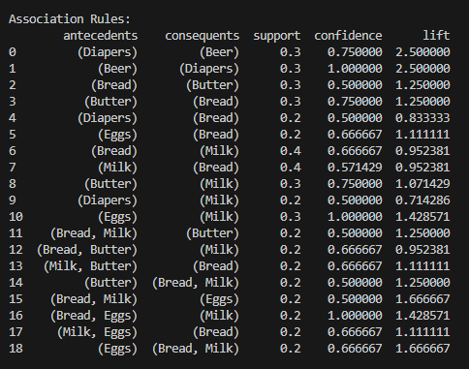
Association rule generation

Slide 9
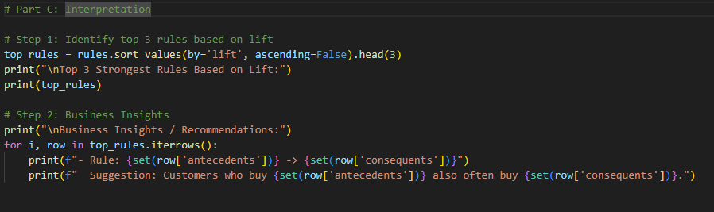
Strongest rule based on the lift

Slide 10
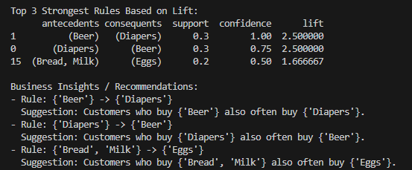
Results of the rules

Slide 11
INTERPRETATION OF THE RULES
The three strongest rules based on the lift
Rule 1: Beer → Diapers
Support = 0.3
Confidence = 1.0
Lift = 2.50 (Highest)
Interpretation:
Customers who buy Beer always buy Diapers in this dataset.
They frequently appear together much more than chance (lift > 1).

Slide 12
Rule two
Rule 2: Diapers → Beer
Support = 0.3
Confidence = 0.75
Lift = 2.50
Interpretation
Customers buying Diapers are very likely to also buy Beer.
This indicates a strong cross-selling relationship.

Slide 13
Rule three
Rule 3: Eggs → Milk
Support = 0.3
Confidence = 1.0
Lift = 1.43
Interpretation:
Every customer who buys Eggs also buys Milk.
Milk is a complementary product often bought with breakfast ingredients

Slide 14
Business recommendations
Bundle or co-locate Beer and Diapers
Since the lift between Beer ↔ Diapers is very high:
Place Beer close to Diapers
Run bundle promotions for example Buy Diapers, get Beer at discount
This increases impulse buys from parents buying diapers.
Promote Eggs + Milk combos
Since Eggs → Milk has strong lift:
Make a breakfast combo promotion (Milk + Eggs)
Place Eggs, Milk, and Bread in a nearby section
Offer discount coupons for buying the combination.

